Slide 1

Ambient Backscatter
Vincent Liu
Aaron Parks, Vamsi Talla,
Shyam Gollakota, David Wetherall, Joshua Smith

Slide 2
Our Goal
Interactive devices that compute and communicate without batteries

Slide 3
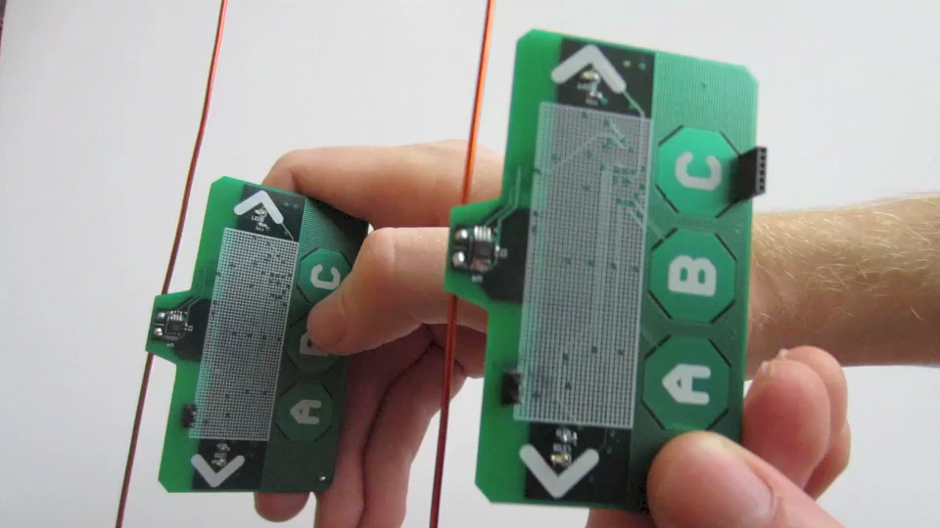
What We Are After
How to power computation, sensing,
and communication?

Slide 4
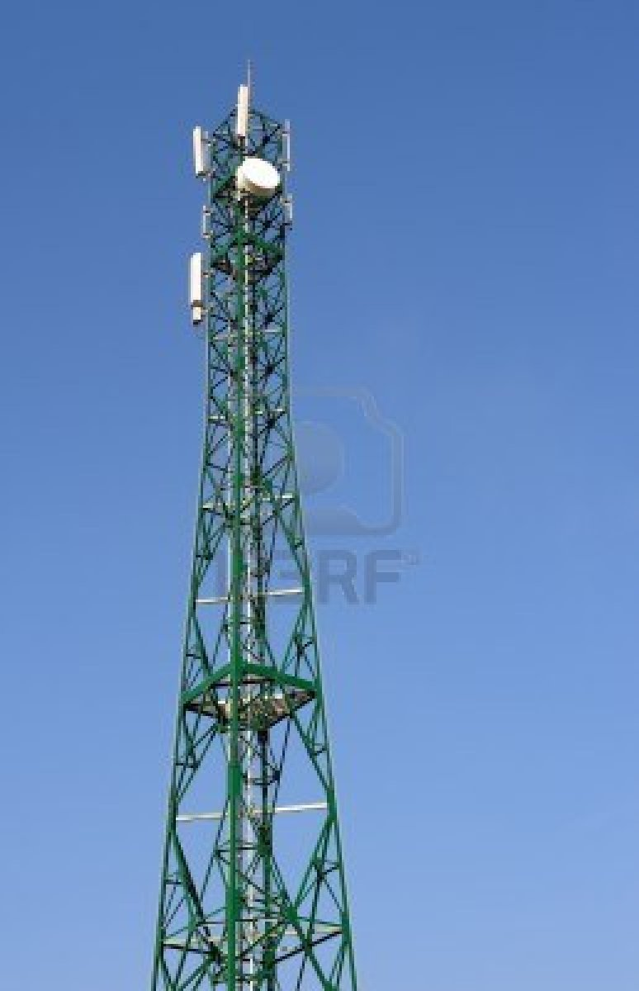
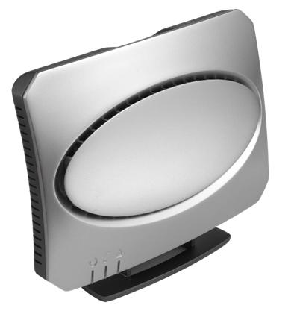
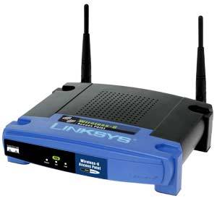
Leverage Existing Wireless Signals
TV
Cellular
Wi-Fi
Available at almost any time and place, rain or shine

Slide 5
Recent Work Harvests 10s of μW [‘09]
Enough for computation and sensing
Orders of magnitude less power than needed for radio communication [‘13]

Slide 6
Challenge: Communication Between Battery-Free Devices
Generating radio signals is expensive
Could duty cycle
Limits interactive applications
Can we communicate without
either device generating radio signals?

Slide 7

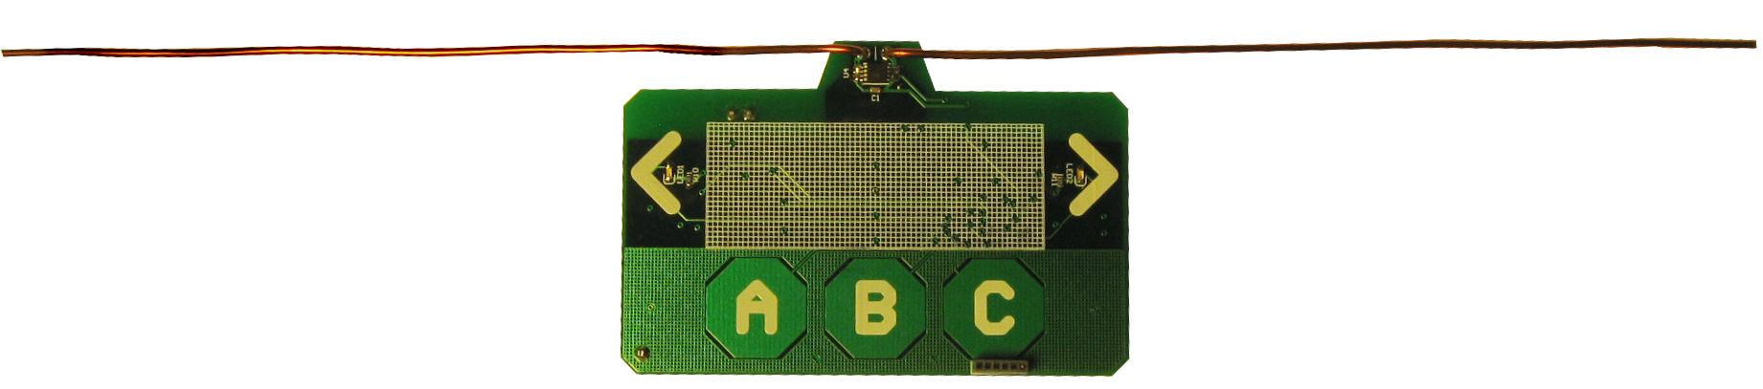
Ambient Backscatter
Use existing signals instead of generating our own
TV Tower
Works with only ~5% of the harvested power!
Reception
Unaffected
Additional
Multipath
Bob
Alice
‘0’ bit – Absorb TV Signals
‘1’ bit – Reflect TV signals

Slide 8
Challenges

Slide 9
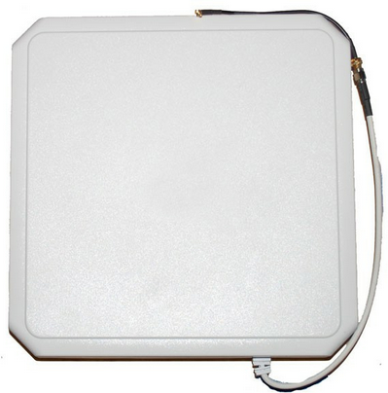
RFID
Ambient Backscatter
Reader
Tag
Reader sends constant wave
Receive chain: 100s of mW
Reader centrally coordinates

Slide 10
RFID
Ambient Backscatter
Reader
Tag
Tag
Tag
Reader sends constant wave
Receive chain: 100s of mW
Reader centrally coordinates
Uses uncontrollable signals
Receive chain: 0.5 μW
Need distributed MAC

Slide 11
Challenges
Extracting backscattered signals from ambient signals we don’t control
Decoding on a battery-free device
Designing distributed MAC for battery-free devices

Slide 12
Challenges
Extracting backscattered signals from ambient signals we don’t control
Decoding on a battery-free device
Designing distributed MAC for battery-free devices

Slide 13
How Do We Extract The Backscattered Signals?
TV Tower
Case 1: Alice absorbs
At Bob: TV signal
Case 2: Alice reflects
At Bob: TV signal
+ Weak Reflection
Alice
Bob
Alice’s reflections change the average amplitude

Slide 14
Solution: Detect Changes in Average Amplitude
Alice Sends 1010…
Alice Inactive
Moving Window Average

Slide 15
If we had digital samples, averaging would be easy
Need power-hungry analog-to-digital converters

Slide 16
Challenges
Extracting backscattered signals from ambient signals we don’t control
Decoding on a battery-free device
Designing distributed MAC for battery-free devices

Slide 17
Use RC Circuits to Average
R
C
Capacitor slowly charges/discharges when voltage is applied/removed
Provides a cheap, analog,
exponential moving average

Slide 18
Use RC Circuits to Average
R
C
Capacitor slowly charges/discharges when voltage is applied/removed
Provides a cheap, analog,
exponential moving average
By picking the right RC values,
we can selectively filter out the high TV frequencies

Slide 19
Now that we can decode bits…
Link Layer
Distributed MAC?
Physical Layer

Slide 20
Challenges
Extracting backscattered signals from ambient signals we don’t control
Decoding on a battery-free device
Designing distributed MAC for battery-free devices

Slide 21
We Use CSMA
CSMA uses carrier sense, i.e. energy detection
Battery-free devices do not have energy levels
Requires power-hungry ADCs
Challenge: Energy detection
without access to the energy levels

Slide 22
Solution: Leverage Hardware Properties for Energy Detection
RC circuit filters out the TV signals → Removes high-amplitude variations
Hardware elements have a threshold → Low-amplitudes don’t change output
In the absence of backscattering,
we see a constant output
Constant Output

Slide 23
Solution: Leverage Hardware Properties for Energy Detection
No backscatter → See all 0s or all 1s
Backscatter → See many transitions
Use bit transitions as proxy for
energy detection

Slide 24
Evaluation

Slide 25
Prototype Using Off-the-Shelf Components
Battery-free
Harvests and backscatters TV signals at 539 MHz
Microcontroller performs computation
LEDs
Touch Sensors

Slide 26
Tested Locations
Seattle area with a 1MW TV tower at 539 MHz
Indoor and outdoor environments
Distances up to 10.5 km from the TV tower
TV power ranged between -24dBm and -8dBm

Slide 27
What Bit Rates Can We Achieve?
Distance
Three bit rates: 10kbps, 1kbps, 100bps
BER versus distance between two devices

Slide 28
What Bit Rates Can We Achieve?
10 kbps
1 kbps
100 bps
These results show the feasibility
of Ambient Backscatter

Slide 29
Applications

Slide 30
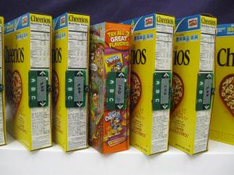
Identifying Misplaced Items
In Grocery stores or Warehouses (e.g., Amazon)
With ambient backscatter, devices can figure out they are misplaced on their own
We built a preliminary system with cereal boxes

Slide 31
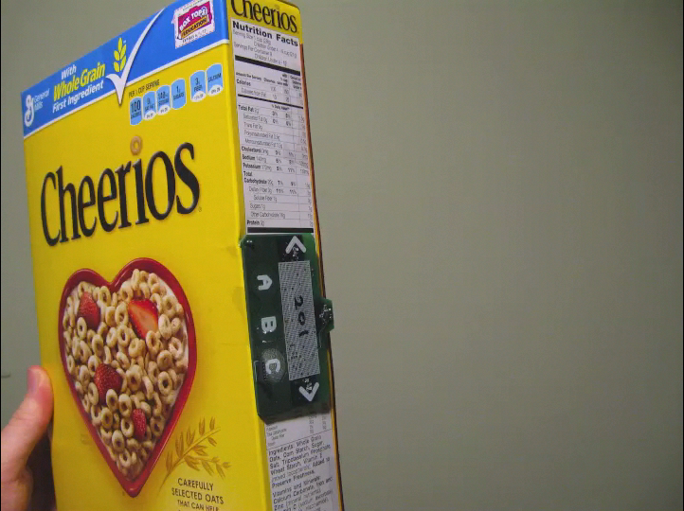
Identifying Misplaced Items
In Grocery stores or Warehouses (e.g., Amazon)
Works even if not all tags are in range of a reader

Slide 32
Conclusion
We develop
The first primitive that enables communication without either device generating RF signals
A battery-free hardware prototype that computes and communicates using only TV signals
We transform existing signals into both a power source and a communication medium
Opens up new research opportunities
abc.cs.washington.edu

