Slide 1
Canaries in the Network
Vincent Liu
Danyang Zhuo, Qiao Zhang, Xin Yang

Slide 2
Jim Gray. “Why Do Computers Stop and What Can Be Done about It?” 1985.
→ Change is dangerous

Slide 3
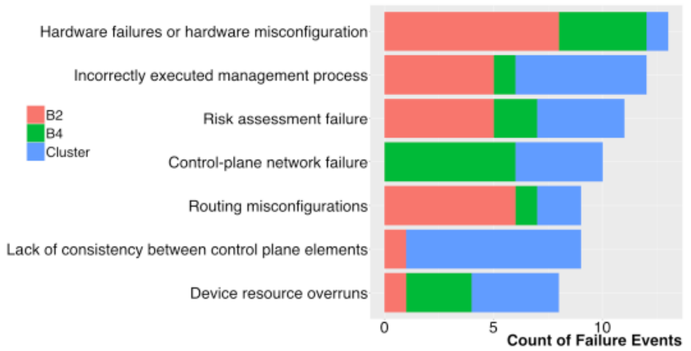
Today’s Large Networks Are Just as Vulnerable
How can we keep the control plane available in the face of change?
Govindan et al. 2016

Slide 4
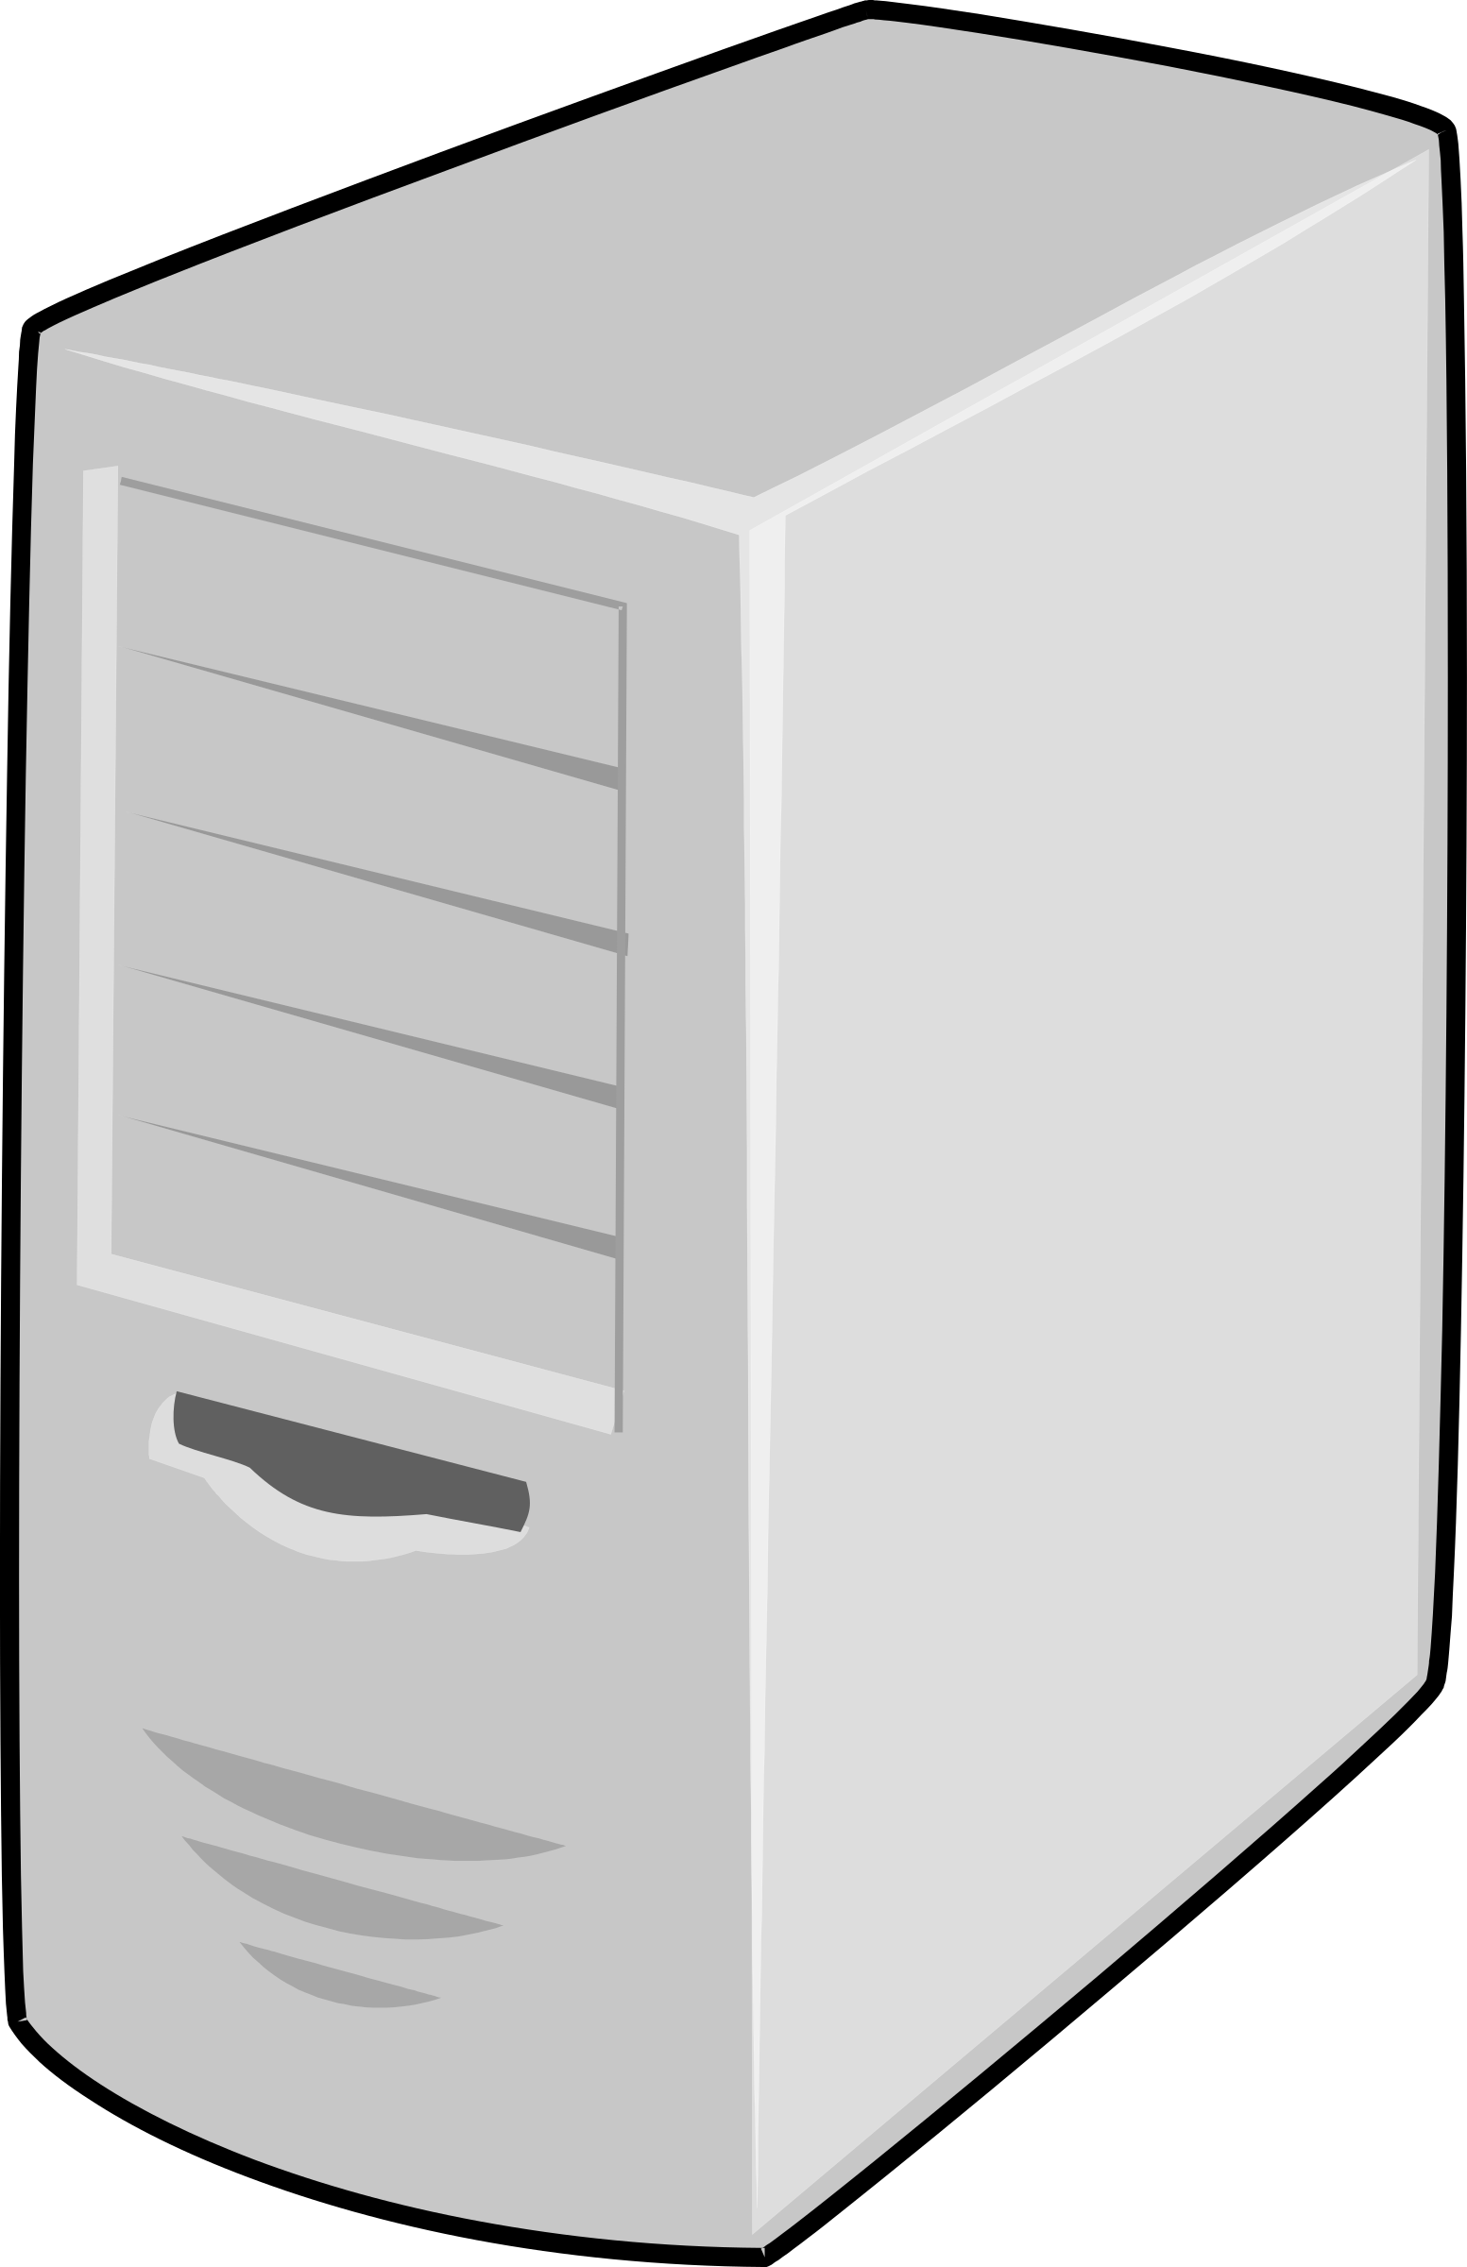
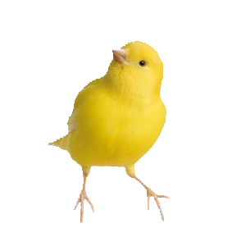
Possible Solution: Canaries
99%
Users
1%

Slide 5
Possible Solution: Network Canaries
Announce: 1.1.1.1/248
Naïve canarying does not protect against many errors
  Networks are connected!
  Errors can propagate

Slide 6
Goal: Isolated Network Canaries
Known
Correct
Split network into known correct and canary control plane instances
Safely roll out changes, reason about their potential effects

Slide 7
Approach: Taint Tracking in the Network
Direct communication between controllers
Indirect communication via mutually controlled hardware
ip route 1.1.1.0/24
Ethernet1/2 1.1.1.1
Announce 1.1.1.1/8

Slide 8
First Step: Notice That This Is Impossible
Partitioned control planes
  The control planes must not talk to one another
Physical isolation
  The same device cannot be managed by two control planes
Global properties (e.g., connectivity)
  If there is a correct path between two servers, they should be able communicate

Slide 9
Second Step: Relax The Requirements
Physical Partitioning prioritizes:
  (1) Partitioned control plane
  (2) Physical isolation
Logical Partitioning prioritizes:
  (1) Partitioned control plane
  (3) Global properties like connectivity

Slide 10
Design 1: Physical Partitioning
Known correct
Canary
Known correct
Known correct
Connected components are each managed by a single control plane
Control planes do not talk to one another or share hardware
Upgrades are rolled one component at a time

Slide 11
Design 1: Physical Partitioning
Known correct
Canary
Known correct
Known correct
Pros:
  Strong isolation
  Simple filtering at boundaries
Cons:
  Some routing policies are impossible
  Failures can cause inefficiency

Slide 12
Design 2: Logical Partitioning
Known correct
Canary
Known correct
Known correct
How do we approximate isolation with many control planes on each switch?
  Isolate state using techniques like VLANs
  Isolate performance using weighted fair queuing
Updates are installed and traffic is incrementally rolled onto a canary slice

Slide 13
Design 2: Logical Partitioning
Known correct
Canary
Known correct
Known correct
Pros:
  Routing is the exact same as today
  Flexible rollout
  Defends against “DDoS” attacks
Cons:
  Not physically isolated
  Non-protected upgrades are sometimes necessary

Slide 14
Open Questions
How does this fit with the rest of the workflow?
For physical partitioning, how do we divide topologies? How do we design topologies that operate well under failure?
Can we build failure-isolated VMs for switch OSes? What hardware abstractions would we need?
Are there other useful ways to partition?

Slide 15
Summary
Our goal: Add true fault isolation to network canaries
Physical partitioning:
  Prioritize control plane isolation and physical isolation
  Split the network into connected subgraphs, each managed independently
Logical partitioning:
  Prioritize control plane isolation and global properties like connectivity
  Split each switch into multiple virtual switches isolated by VLANs, WFQing

