Slide 1
F10: A Fault-Tolerant Engineered Network
Vincent Liu, Daniel Halperin,
Arvind Krishnamurthy, Thomas Anderson
University of Washington

Slide 2
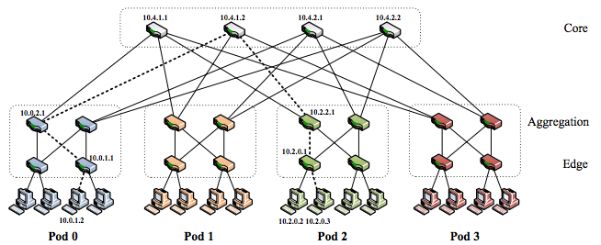
Today’s Data Centers
*From Al-Fares et al.
SIGCOMM ‘08
Today’s data centers are built using multi-rooted trees
Commodity switches for cost, bisection bandwidth, and resilience to failures

Slide 3
FatTree Example: PortLand
Heartbeats to detect failures
Centralized controller installs updated routes
Exploits path redundancy

Slide 4
Unsolved Issues with FatTrees
Slow Detection
  Commodity switches fail often
  Not always sure they failed (gray/partial failures)
Slow Recovery
  Failure recovery is not local
  Topology does not support local reroutes
Suboptimal Flow Assignment
  Failures result in an unbalanced tree
  Loses load balancing properties

Slide 5
F10
Co-design of topology, routing protocols and failure detector
  Novel topology that enables local, fast recovery
  Cascading protocols for optimal recovery
  Fine-grained failure detector for fast detection
Same # of switches/links as FatTrees

Slide 6
Outline
Motivation & Approach
Topology: AB FatTree
Cascaded Failover Protocols
Failure Detection
Evaluation
Conclusion

Slide 7
Why is FatTree Recovery Slow?
dst
src
Lots of redundancy on the upward path
Immediately restore connectivity at the point of failure

Slide 8
Why is FatTree Recovery Slow?
dst
src
src
No redundancy on the way down
Alternatives are many hops away
No direct path
Has alternate path

Slide 9
Type A Subtree
Consecutive Parents
1
2
3
4
x
y

Slide 10
Type B Subtree
Strided Parents
1
2
3
4
x
y

Slide 11
AB FatTree

Slide 12
Alternatives in AB FatTrees
dst
src
src
More nodes have alternative, direct paths
One hop away from node with an alternative
No direct path
Has alternate path

Slide 13
Cascaded Failover Protocols
A local rerouting mechanism
  Immediate restoration
A pushback notification scheme
  Restore direct paths
An epoch-based centralized scheduler
  globally re-optimizes traffic
μs
ms
s

Slide 14
Local Rerouting
u
dst
Route to a sibling in an opposite-type subtree
Immediate, local rerouting around the failure

Slide 15
Local Rerouting – Multiple Failures
u
dst
Resilient to multiple failures, refer to paper
Increased load and path dilation

Slide 16
Pushback Notification
u
u
Detecting switch broadcasts notification
Restores direct paths, but not finished yet
No direct path
Has alternate path

Slide 17
Centralized Scheduler
Related to existing work (Hedera, MicroTE)
Gather traffic matrices
Place long-lived flows based on their size
Place shorter flows with weighted ECMP

Slide 18
Outline
Motivation & Approach
Topology: AB FatTree
Cascaded Failover Protocols
Failure Detection
Evaluation
Conclusion

Slide 19
Why are Today’s Detectors Slow?
Based on loss of multiple heartbeats
  Detector is separated from failure
Slow because:
  Congestion
  Gray failures
  Don’t want to waste too many resources

Slide 20
F10 Failure Detector
Look at the link itself
  Send traffic to physical neighbors when idle
  Monitor incoming bit transitions and packets
  Stop sending and reroute the very next packet
Can be fast because rerouting is cheap

Slide 21
Outline
Motivation & Approach
Topology: AB FatTree
Cascaded Failover Protocols
Failure Detection
Evaluation
Conclusion

Slide 22
Evaluation
Can F10 reroute quickly?
Can F10 avoid congestion loss that results from failures?
How much does this effect application performance?

Slide 23
Methodology
Testbed
  Emulab w/ Click implementation
  Used smaller packets to account for slower speed
Packet-level simulator
  24-port 10GbE switches, 3 levels
  Traffic model from Benson et al. IMC 2010
  Failure model from Gill et al. SIGCOMM 2011
  Validated using testbed

Slide 24
F10 Can Reroute Quickly
F10 can recover from failures in under a millisecond
Much less time than a TCP timeout

Slide 25
F10 Can Avoid Congestion Loss
PortLand has 7.6x the congestion loss of F10 under realistic traffic and failure conditions

Slide 26
F10 Improves App Performance
Speedup of a MapReduce computation
Median speedup is 1.3x

Slide 27
Conclusion
F10 is a co-design of topology, routing protocols, and failure detector:
  AB FatTrees to allow local recovery and increase path diversity
  Pushback and global re-optimization restore congestion-free operation
Significant benefit to application performance on typical workloads and failure conditions
Thanks!

