Slide 1
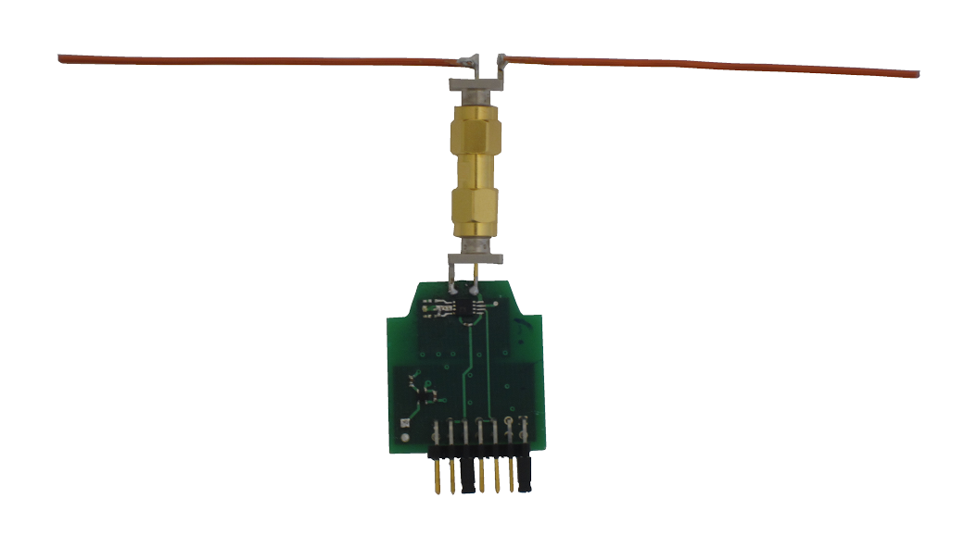

Full-duplex Backscatter for <1 μW
Vincent Liu
Vamsi Talla, Shyam Gollakota

Slide 2
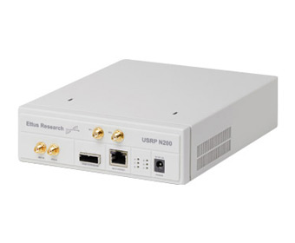
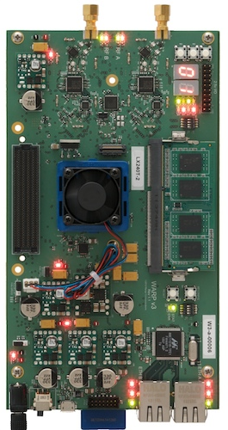
Why Is This Hard?
Existing solutions require O(1W)
1,000,000x too much!

Slide 3
Full-duplex Backscatter
First full-duplex design for battery-free devices
Same frequency, single antenna

Slide 4

Full-duplex Backscatter
RF source
Data (1 kbps)
Feedback (100 bps)
Alice
Bob
Brings self-interference down to the noise floor using < .75 uW

Slide 5
Why Do We Care? Energy Is The Bottleneck!
Threshold to
transmit a packet
Recovery from collisions and errors takes a long time
Capacitor charging is exponential in time

Slide 6
Why Do We Care? Energy Is The Bottleneck!
Full-duplex can help fix this problem
Instantaneous feedback enables a better network
Collision detection (100x recharge time reduction)
Error correction (10x overhead reduction for every packet)

Slide 7
How do we get full-duplex on battery-free devices?
How do we use instantaneous feedback to design a power-efficient network stack?

Slide 8
How do we get full-duplex on battery-free devices?
How do we use instantaneous feedback to design a power-efficient network stack?

Slide 9
Backscatter Overview
RF Source
Alice absorbs:
Existing signal
Alice reflects:
Existing signal
& Reflection
Alice
Bob

Slide 10
Challenge: Bob’s Reflections Lose Information
RF Source
Alice absorbs:
Existing signal
Alice reflects:
Existing signal
& Reflection
Alice
Bob
Bob absorbs
Bob reflects

Slide 11
Solution: Change Phase Instead
Bob sends ‘0’:
Existing signal
& θ shift
Bob sends ‘1’:
Existing signal
& -θ shift
RF Source
Alice
Bob
Alice can decode Bob’s signal
Bob can decode Alice’s signal
Bob absorbs
Bob reflects

Slide 12
Practically, phase modulation is imperfect
Residual interference

Slide 13
Solution: Leverage Difference in Rates to Eliminate Residual Interference
Data (1 kbps)
Feedback (100 bps)
Alice
Bob
Remove interference with high-pass filter
Remove interference with low-pass filter
Can be done with cheap, passive circuits at
NO additional power

Slide 14
Is Our Cancellation Effective?
Reduces self-interference to noise floor

Slide 15
How do we get full-duplex on battery-free devices?
How do we use instantaneous feedback to design a power-efficient network stack?

Slide 16
Challenge: Energy Is the Bottleneck
Recovery from collisions/errors takes a long time
We use Full-duplex Backscatter to achieve instantaneous feedback

Slide 17
Protocol: Acknowledge Data at a Bit Level
40 bits
Forward data
channel
1
2
3
4
5
Feedback
channel
1
2
3
4
5
4 bits
Time
Split packet into 40-bit chunks
Receiver returns a checksum of each chunk
Sender verifies checksum

Slide 18
Does Full-duplex Help With Collisions?
Detect collisions and stop transmissions
100x improvement in recharge time
64-byte packet size

Slide 19
Does Full-duplex Help With Error Correction?
Recover from errors by retransmitting only the failed bits
>90% decrease in overhead
64-byte packet size

Slide 20
Conclusion
We show
The first full-duplex design for battery-free devices
A power-efficient network stack that has significant gains across the board
Re-design networking primitives with power as a first-class citizen
MIMO (SIGCOMM’14), coding (SIGCOMM’14), UWB (?), TCP/IP (?), …

